Slide 1
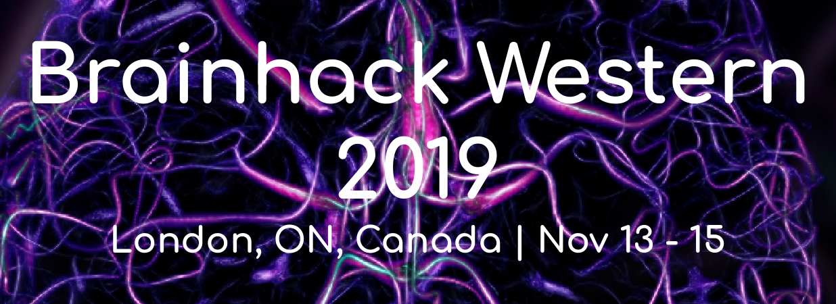
Intro to Deep Learning
Presented by Jordan DeKraker and Haider Al-Tahan
https://github.com/haideraltahan/DeepLearningIntro-BrainHack

Slide 2
Goals
Basic introductions to Neural Networks & training with backpropagation
Common architectures, semi- and sparse-supervision problems
Problems and similarities to biological information processing
Advanced topics & discussions

Slide 3
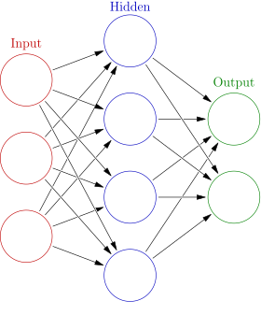
My first NN
Iterative backpropagation
Look at the ‘supervision’ signal, the difference with the actual output is the error
Adjust weights accordingly
This is applied many times in random changing orders, but with a small ‘step size’ or learning rate
1 neuron will converge on linear regression
N neurons can approximate any function
Train, test, and validation datasets are kept separate

Slide 4
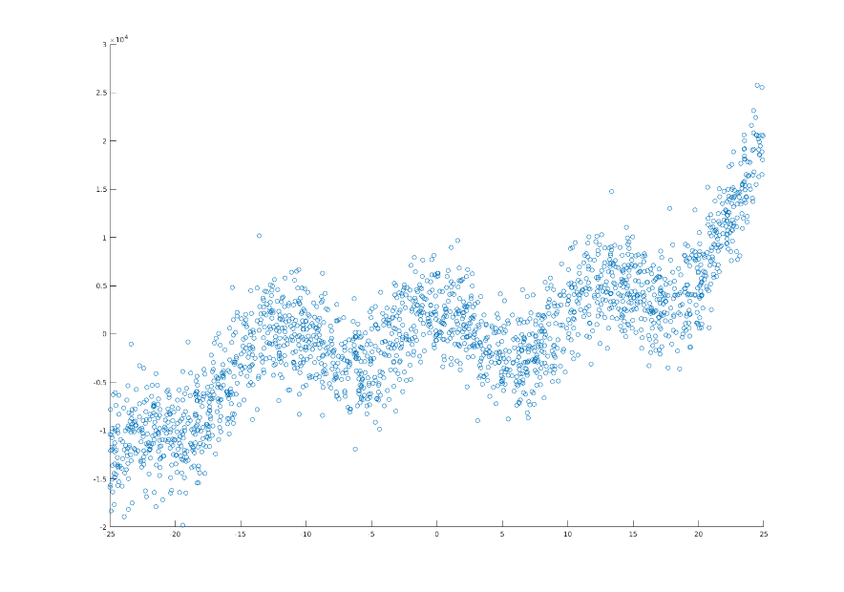
Overfitting and Generalizability
Neurons can act in parallel or can converge, or can converge at any given depth & any given combination

Slide 5
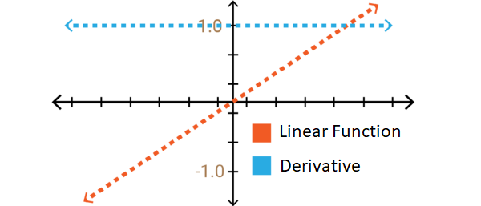
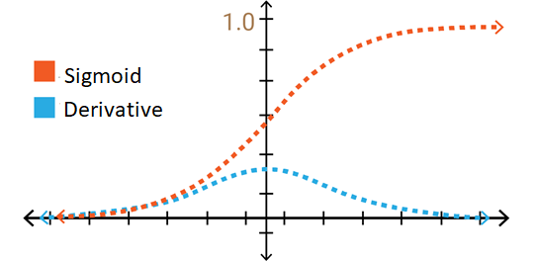
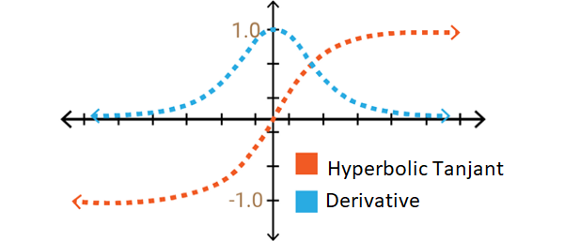
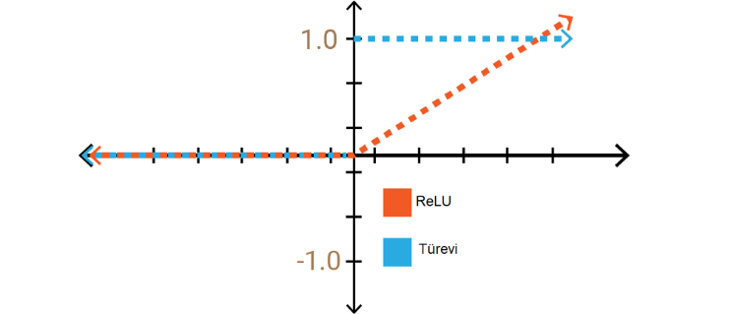
Non-linear activation functions
Activation functions are applied to the sum of a neuron’s inputs
‘Bias’ is typically introduced at each neuron to shift activation functions left or right
Biological analogues could be dendritic branching patterns (ie. the thing in between the sum of inputs and the soma of the cell), or expression profiles, or even microcircuits at longer timescales.
If you had a good reason, any basis function could be used (e.g. sine&cosine for Fourier transform)
Must be differentiable for error to be backpropagated
In practice, simplicity is better (eg. fast simple function, same function for all neurons)

Slide 6
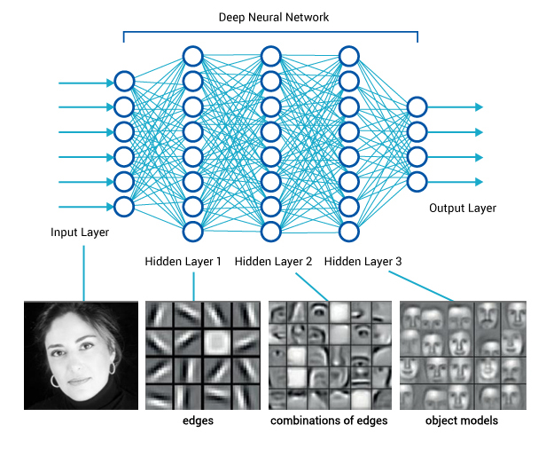
Stacking layers
N neurons in a layer increases its capacity/precision
L layers increases overall abstraction, or what I like to call ‘multiple-realizability’

Slide 7
Stacking layers
NNs will try to ‘cheat’ whenever they can
e.g. look at a few pixels, if they match ‘input A’ then produce ‘output A’ (1:1 mapping)
We need to force the network to learn deeper conjunctions of features by ‘swapping out’ features that are interchangeable
Having many samples means its easier to
detect regularities between higher-level ‘conjunctions’ of features
than it is to
match every low level feature

Slide 8
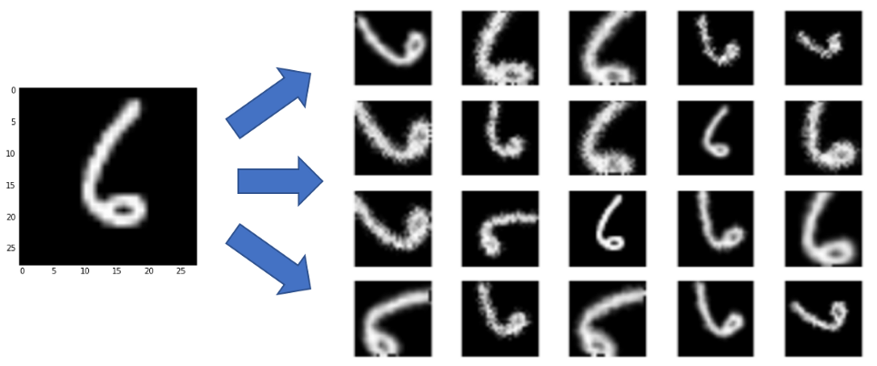
Augmentation and interchangeability
Augmentation changes pixel values without changing their higher-level features
E.g. random shifts, scales, rotations, flips, noise, diffeomorphisms
There is an infinite space of possible augmentations
However, augmentations need to be constrained:
Interchangeable (E.g. 180⁰ rotation 6→9)
Realistic (not helpful if never encountered in test datasets)

Slide 9
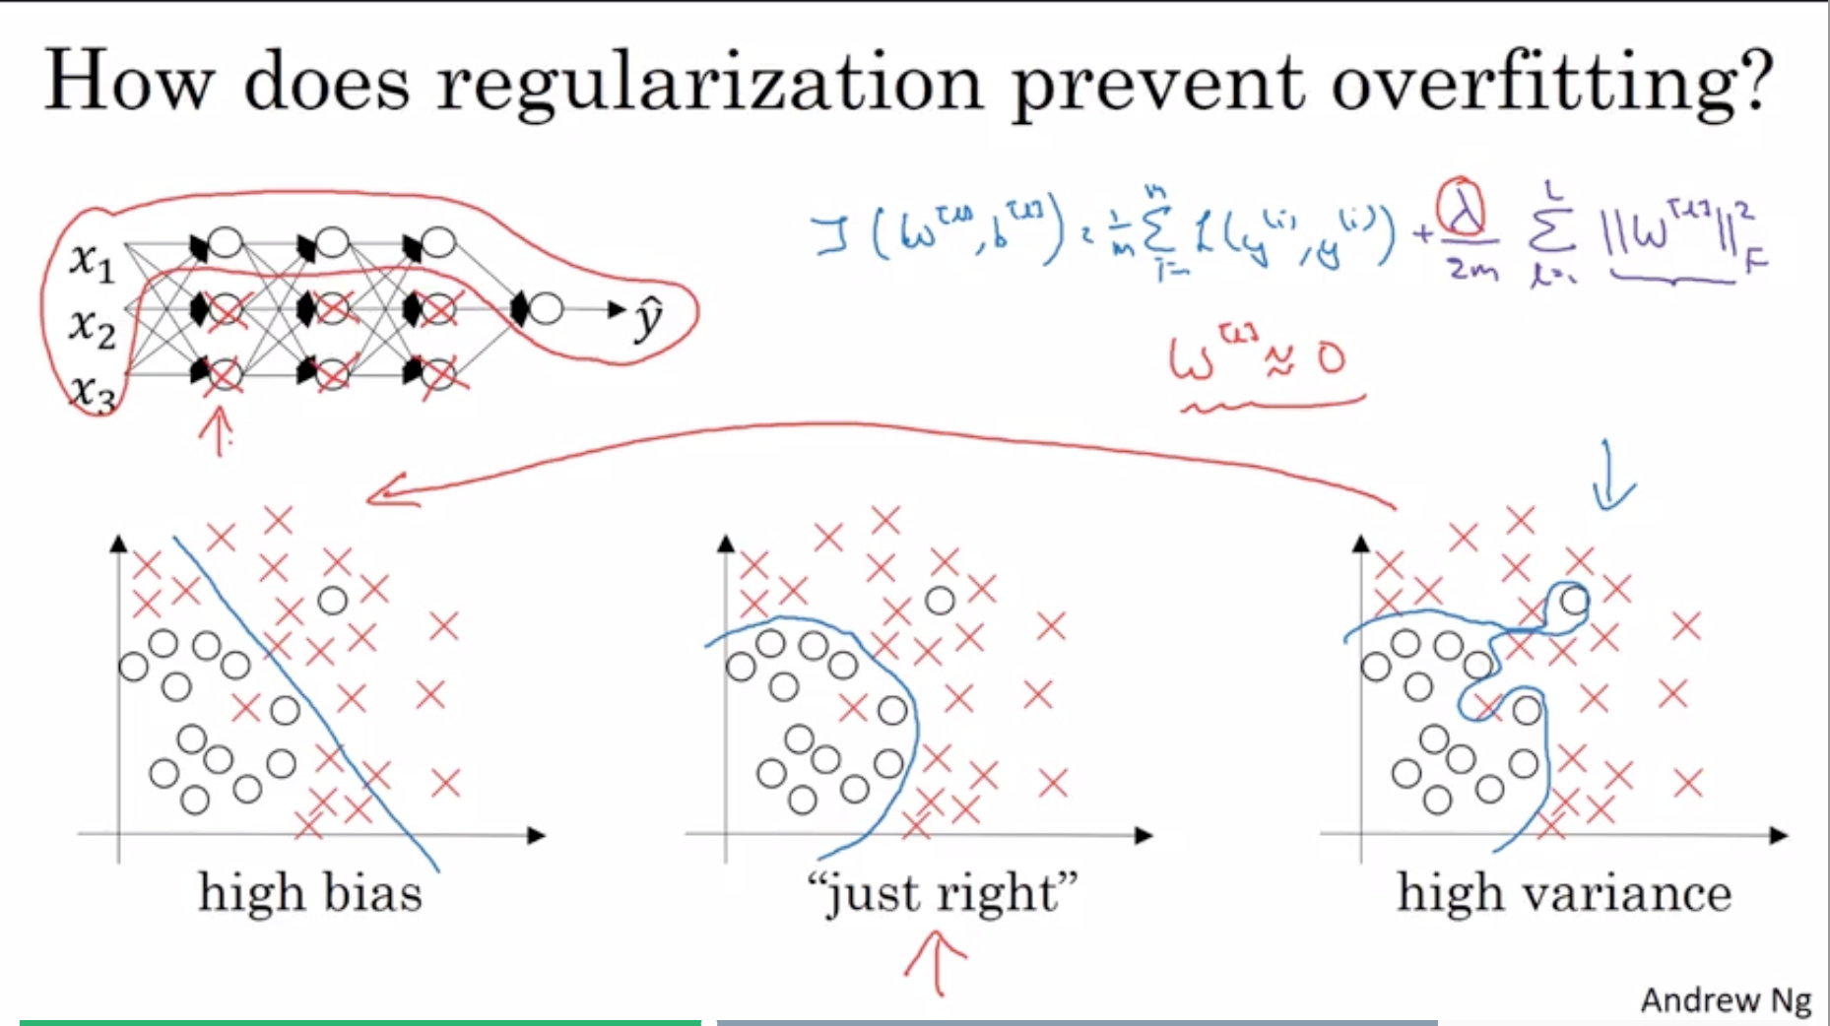
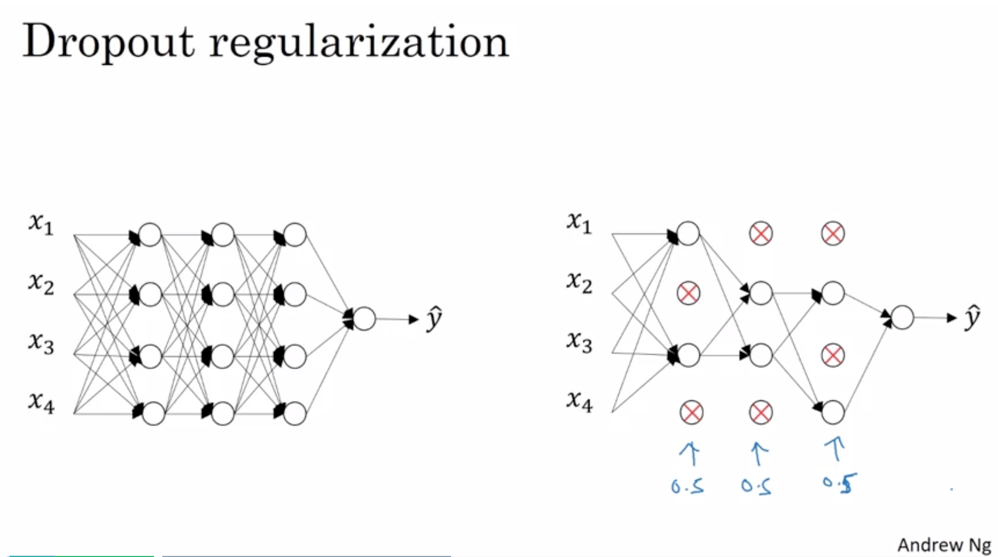
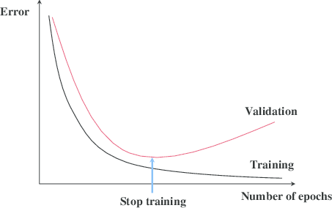
Other ways to improve
Regularization: L1 or L2
Add a ‘cost’ to having weights that are too large
Regularization: drop-out
Effectively training multiple networks in parallel then averaging them. Can’t rely on any one feature, so have to spread out weights
Stopping early:
Even when we do all of the above, eventually the network will find idiosyncratic ‘shortcuts’, especially in small training datasets

Slide 10
Part 1: rest & digest
A basic NN can map inputs to outputs, but we need to give it some guidelines. Most ML libraries will do all this automatically, but sometimes they need troubleshooting
Broader concepts:
precision/capacity
abstraction/multiple-realizability/interchangeability
You need to trick your NN into learning deeply. Don’t let it trick you!

Slide 11
Goals
Basic introductions to Neural Networks & training with backpropagation
Common architectures, semi- and sparse-supervision problems
Problems and similarities to biological information processing
Advanced topics & discussions

